Slide 1

House Safeguard System
Chenwei Tang
Shuhan Qian
Zeyu Gu

Slide 2
Vision
House safeguard system is an effective measure to solve the security management at the entrance and exit of important departments. Applicable to various confidential departments, such as banks, hotels, parking lot management, computer rooms, factories, etc.
This system equipped with a camera can capture the image of the visitor and remind the user the identification of the intruder coming in the building.

Slide 3
Parts List
QT PY RP2040
DSD TECH HC-05 Bluetooth Module
Arducam Pico4ML
ADPS 9960
Buzzer
VGA Cable

Slide 4
Block Diagram
RP2040 controls modules in the system. APDS9960 measures distance from the visitor. When the visitor is close to a certain distance, the buzzer alerts, and the camera in Pico4ML captures the image and sends to the screen. After checking the identification of the visitor, the user can change the status of the system (alarm on or off) through the Bluetooth.
Screen
Pico4ML
Camera module to capture the visitor’s image
VGA
Smart Phone
HC-05 Bluetooth
Module
QT PY RP2040
Microcontroller
Mobile phone to receive and send data
Bluetooth to connect the user’s phone and transmit data
Buzzer
APDS 9960
APDS9960 to measure the distance from the visitor

Slide 5
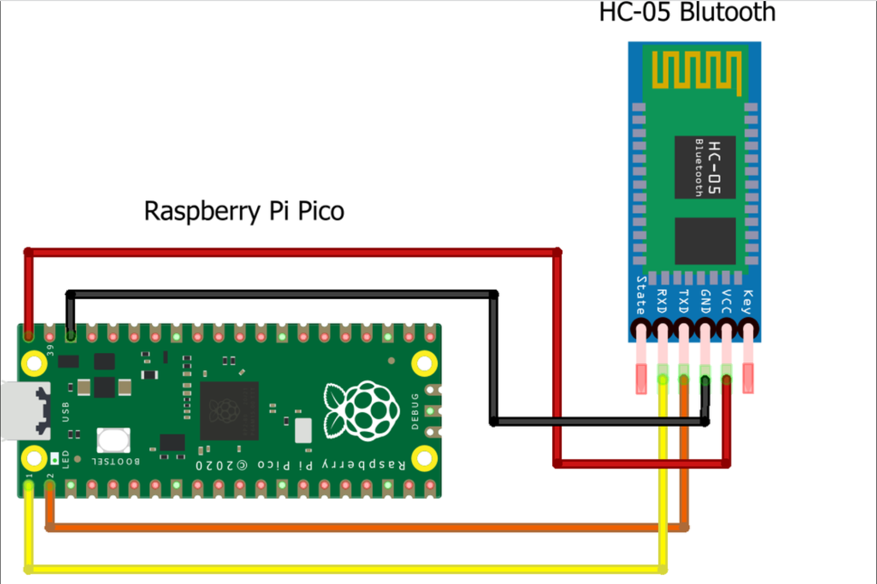
Design: Bluetooth
HC-05 bluetooth uses the 2.45GHz frequency band. The transfer rate of the data can vary up to 1Mbps and is in range of 10 meters. The HC-05 module can be operated within 4-6V of power supply. It supports baud rate of 9600, 19200, 38400, 57600, etc.

Slide 6
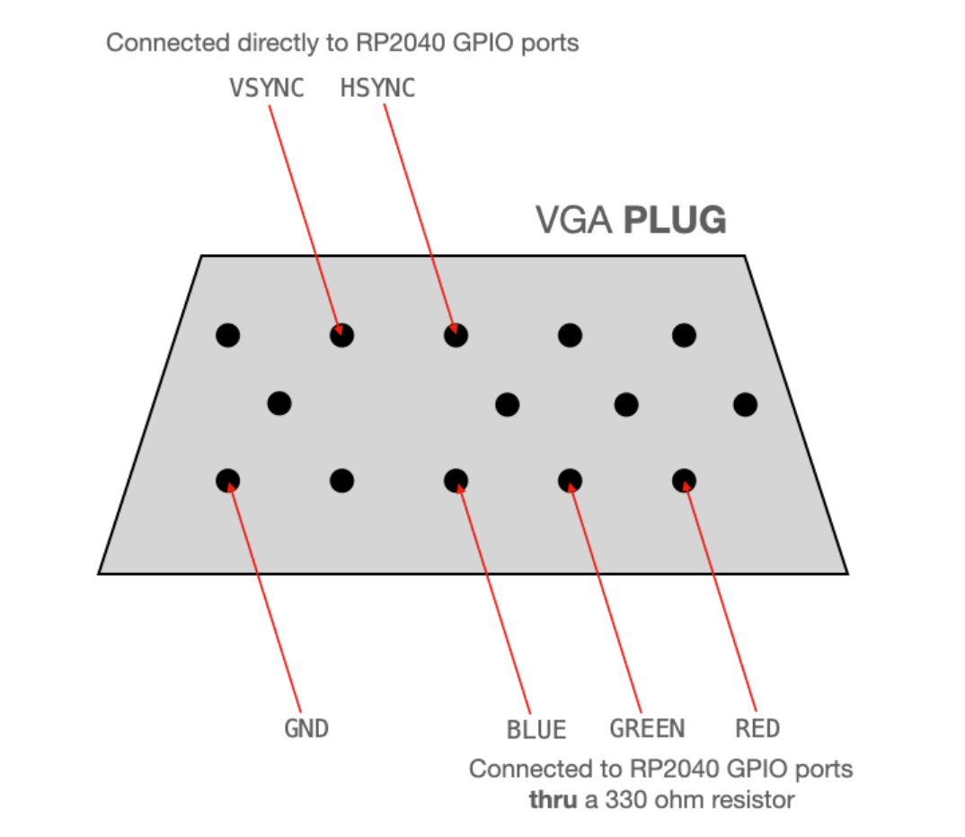
Design: VGA
Both of HSYNC and VSYNC are connected from the GPIO ports of the RP2040 to the appropriate pins on the VGA connector. The display expects a voltage in the range of 0-0.7V. The output from the RP2040 is 3.3V. So, putting resistors between the R/G/B color pins and the VGA connector creates a voltage divider that keeps the output voltage within a safe range for the display.

Slide 7
Design: Screen
pixel=image_buf[(2+320-i/2)*324+(2+40+j/3)];
324
640
324
Image_buf
320
VGA

Slide 8
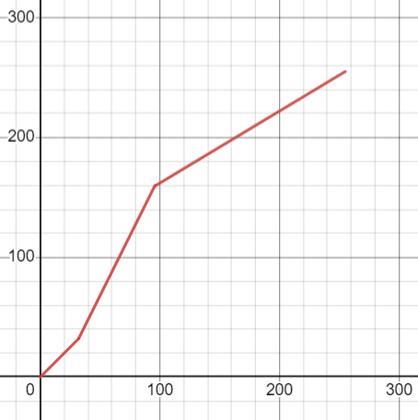
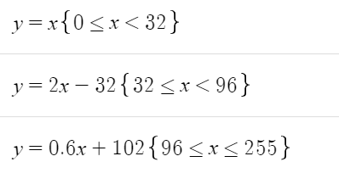
Design: Screen
The brightness of most pixels on face are concentrated in [32,96). We expand this interval by a coefficient of 2. Therefore, there are more colors shown on face. The image presents more clearly. We also use “pixel=pixel/32” to set pixels as 8 colors.

Slide 9
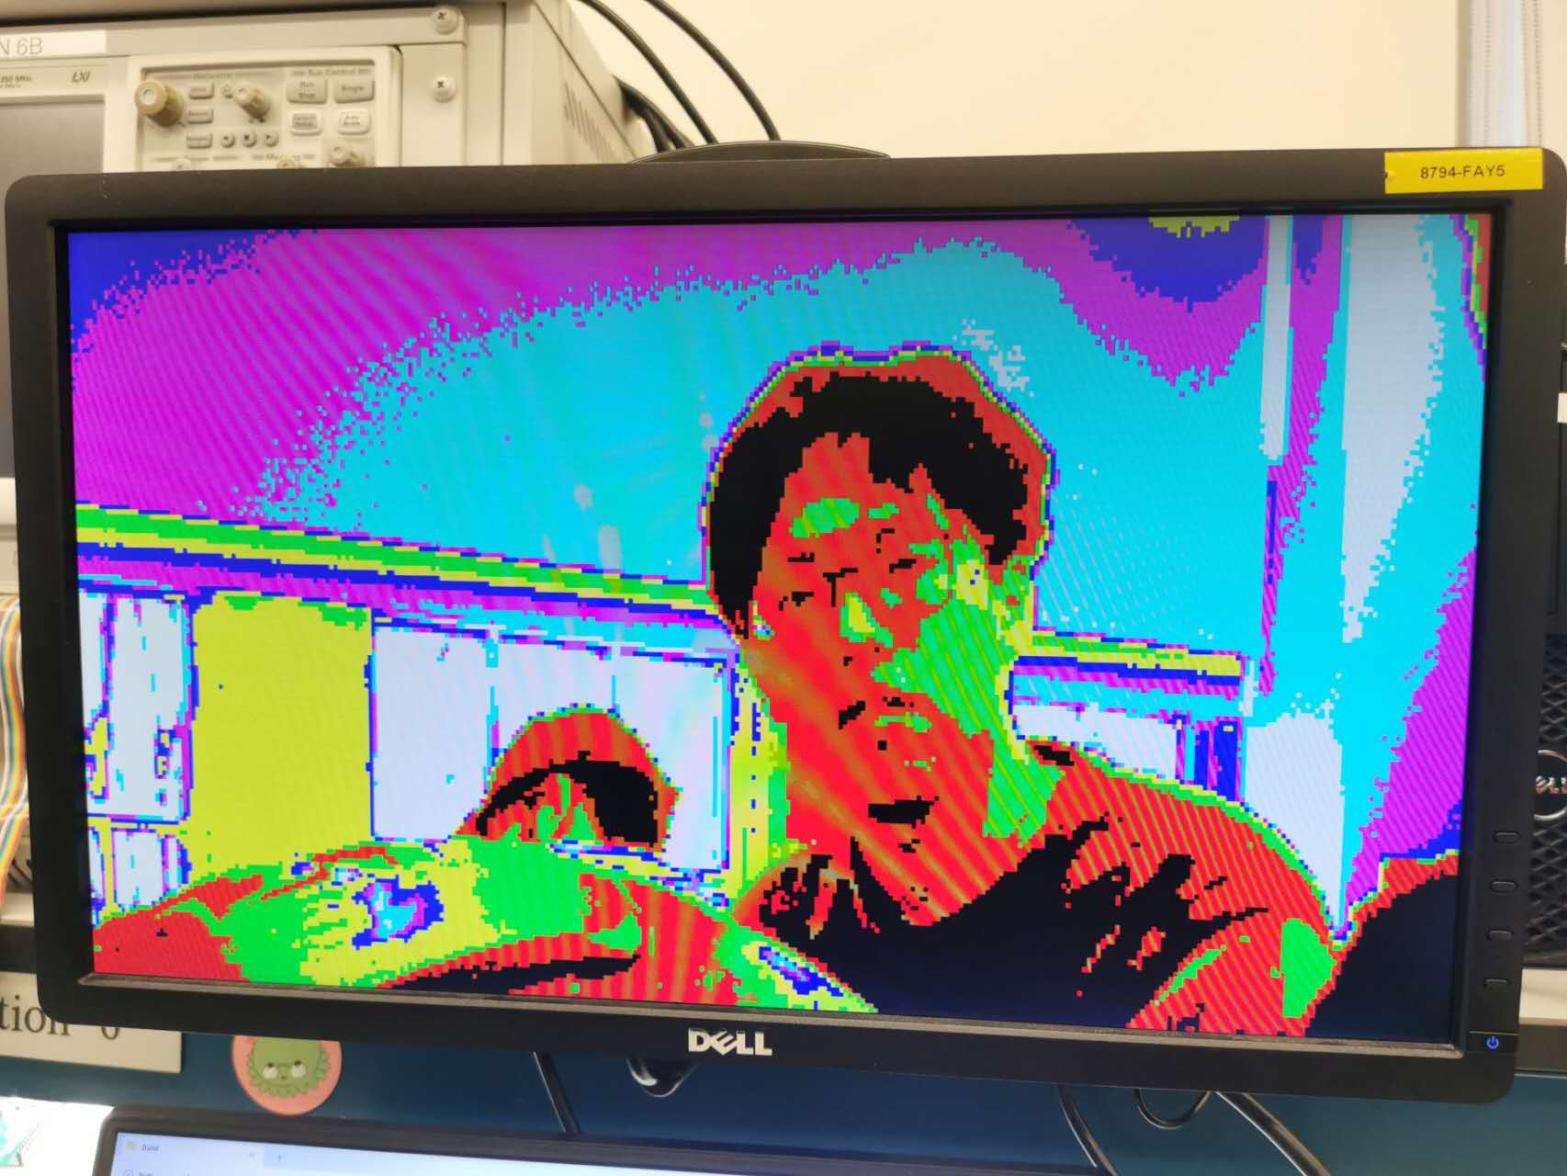
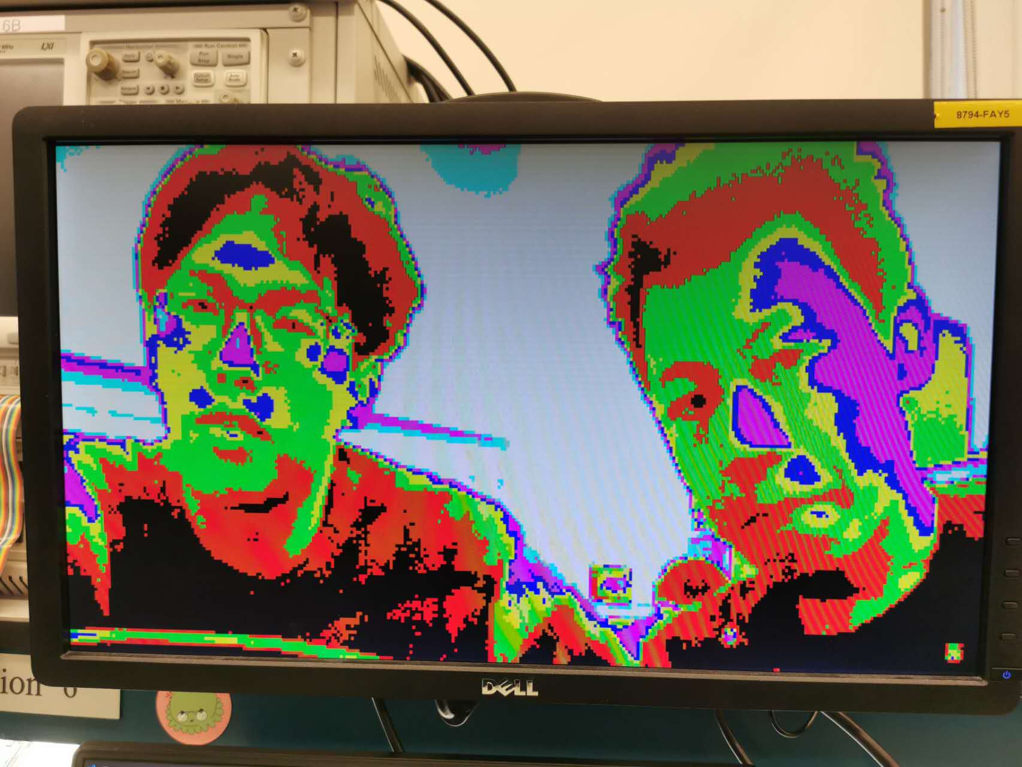
Design: Screen

Slide 10
Design: Code
At first, we could not use function “gpio_get()”. Then I tried to disable LCD code. The function could work correctly. I think there is not enough ROM or RAM to run the code since there are too many very large arrays.

Slide 11
Future
This safeguard system still has great potential. A high-performance microcontroller transmits the real-time video to the user’s phone. A high-quality camera captures high-pixel images so that key features of visitors can be extracted easily. An App developed on the mobile phone can perform face recognition to identify visitors automatically.

